Slide 1

Reproducing DeepCluster: Unsupervised Learning of Visual Features via Clustering
Student: Zahra Helalizadeh
Instructor: Prof. H. Shah Mansouri, Prof. H. Salavati
Institution: Sharif University of Technology

Slide 2
Table of contents
01
02
03
Introduction & Problem Statement
Methodology & Implementation
Related Work
04
05
06
Experiments & Results
Conclusion & Future Work
Discussion

Slide 3
01
Introduction & Problem Statement

Slide 4
Introduction
Progress in computer vision is driven by large labeled datasets (e.g., ImageNet).
Limitations:
Expensive & time-consuming annotations
Dataset bias & domain specificity
Key Question: Can we learn useful visual features without labels?

Slide 5
Problem Statement
Traditional clustering fails when combined with deep networks → trivial solutions.
Challenge:
Avoiding collapse into one cluster
Handling imbalanced clusters
Goal: Train CNNs in an unsupervised manner to produce transferable features.

Slide 6
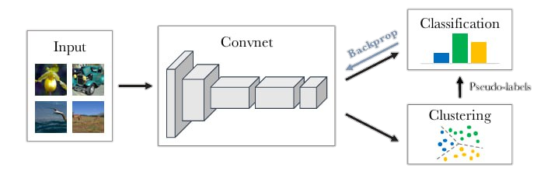
Paper Contribution (DeepCluster, Caron et al. 2018)
Iterative Clustering + Training:
Extract CNN features → cluster with k-means.
Assign pseudo-labels from clusters.
Train CNN with pseudo-labels.
Avoids trivial solutions with:
Empty cluster reassignment
Uniform cluster sampling
Scales to large datasets (ImageNet, YFCC100M).
Figure 1: Illustration of the proposed method

Slide 7
02
Related Work

Slide 8
Related Work
Clustering-based: Bag-of-Features, k-means + handcrafted features.
Self-supervised: Pretext tasks (Jigsaw, Colorization, Inpainting, Context prediction).
Generative Models: Autoencoders, GANs (limited discriminative power).
Why DeepCluster is Different: scalable, domain-agnostic, no handcrafted tasks.

Slide 9
03
Methodology & Implementation

Slide 10
Methodology Overview
Dataset: STL-10 (100k unlabeled images + 10 classes).
Preprocessing: Sobel filtering, standard augmentations.
Model: AlexNet backbone + linear classifier.
Training: Alternating clustering & supervised training with pseudo-labels.

Slide 11
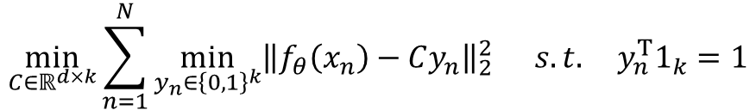
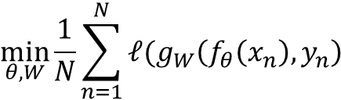
Theoretical Foundation
Supervised Learning Objective:
$$\min_{θ, W}{\frac{1}{N}\sum_{n=1}^{N}{ℓ(g_{W}\left(f_{θ}\left(x_{n}\right),y_{n}\right)}}$$
Unsupervised Learning via Clustering:
$$\min_{C∈ℝ^{d×k}}{\sum_{n=1}^{N}{\min_{y_{n}∈{\left\{0,1\right\}}^{k}}{{\left\|f_{θ}\left(x_{n}\right)−Cy_{n}\right\|}_{2}^{2}}}} s.t. y_{n}^{T}1_{k}=1$$

Slide 12
Implementation Details
Clustering: MiniBatchKMeans (k=10).
Hyperparameters:
Epochs = 15, Batch size = 128
LR = 0.05, Momentum = 0.9
Differences from paper:
Smaller dataset (STL-10 vs ImageNet)
Fewer clusters (10 vs 10,000)
Fewer epochs (15 vs 400)
AlexNet only (no VGG16)
@dataclass
class DEEPCLUSTER_TRAIN_CFG:
k: int = 10
epochs: int = 15
batch_size: int = 128
lr: float = 0.05
momentum: float = 0.9
weight_decay: float = 1e-4
aug_color_jitter: bool = True
balance_sampling: bool = True
reassign_empty: bool = True
checkpoint_dir: str = "./checkpoints_deepcluster"

Slide 13
04
Experiments & Results

Slide 14
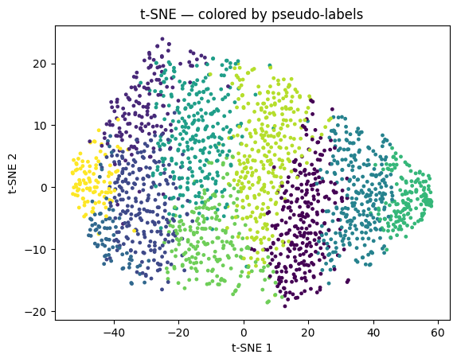
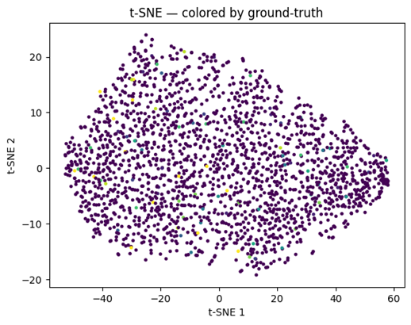
Visualizations of Learned Representations
Filters: Sobel + CNN → edge & gradient detectors.
t-SNE embeddings:
Grouping by pseudo-labels.
Partial alignment with ground-truth categories.
Figure 4: t-SNE Projection (pseudo-label colors)
Figure 5: t-SNE Projection (ground-truth colors)

Slide 15
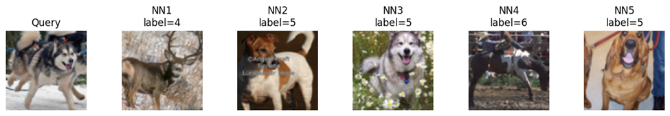
Nearest-Neighbor Retrieval
Retrieves visually similar images (shapes, colors, backgrounds).
Still dominated by low-level similarity.
Figure 6: Example Retrievals (query + top-5 neighbors)

Slide 16
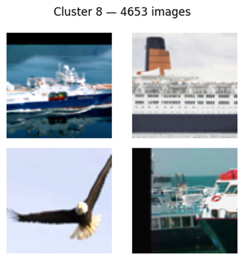
Cluster Samples
Random images per cluster:
Some clusters capture animals vs. vehicles.
Semantics not always consistent.
Figure 7: Cluster Montage Samples

Slide 17
Quantitative Results
Linear probe (STL-10): 23.8%
kNN (k=5): 27.3%
Pascal VOC transfer (mAP): 0.1377
Comparison:
Original DeepCluster (ImageNet, VGG16): 75–80%

Slide 18
05
Discussion

Slide 19
Discussion
Impact of dataset: small STL-10 limits cluster richness.
Impact of architecture: AlexNet weaker than VGG16.
Strengths: scalable, general-purpose, simple, domain-agnostic.
Limitations: computational cost, hyperparameter sensitivity, small dataset weakness.

Slide 20
Conclusion
06

Slide 21
Conclusion
Reproduced DeepCluster with STL-10.
Verified iterative clustering + pseudo-labeling works without labels.
Results qualitatively similar, quantitatively weaker than original due to dataset/architecture constraints.

Slide 22
Future Work
1. Scale to ImageNet / larger datasets.
2. Increase clusters (k=1000+).
3. Test modern architectures (ResNet, ViT).
4. Compare with newer methods (SimCLR, BYOL, DINO).
5. Improve clustering efficiency.
6. Apply to domain-specific datasets (medical imaging, satellite, etc.).

Slide 23
References
Caron et al. (2018) DeepCluster paper.
STL-10 dataset (Coates & Ng, 2011).
PyTorch, Scikit-learn, NumPy, Matplotlib.
t-SNE (van der Maaten & Hinton).

